Slide 1
A gentle introduction to Asterisk
Anthony Critelli

Slide 2
Before we get to Asterisk
A bit about IP telephony

Slide 3
Protocols
We usually talk about two protocols in VoIP architectures
Signaling – carries information about call setup, routing, teardown, etc.
  Session Initiation Protocol (SIP)
  Skinny Client Control Protocol (SCCP)
  H.323
Transport – carries the actual encoded audio or video
  Realtime Transport Protocol
  Realtime Transport Control Protocol

Slide 4
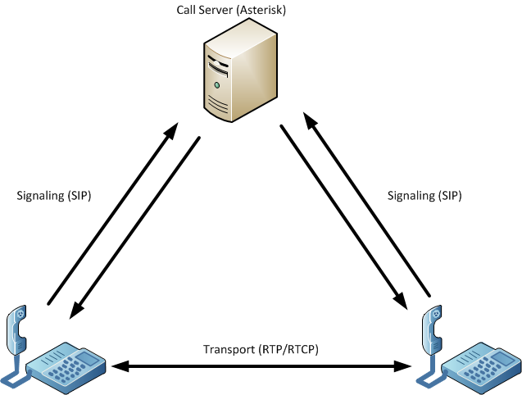
Notes:
This is a diagram representation of the previous slide. It shows a typical VoIP architecture.
Signaling protocols, such as SIP, typically occur between the call server and the endpoints. Here, we can see two SIP phones communicating with an Asterisk call server.
Transport protocols, almost always RTP and RTCP (used for collecting call statistics), usually occur directly between the SIP endpoints.
Although this is the norm, there are some architectures that pass all transport traffic through the call server.

Slide 5
Now onto Asterisk

Slide 6
What is Asterisk?

Slide 7
“Asterisk is like a box of Legos for people who want to create communications applications.”
www.asterisk.org
Notes:
This is an excellent way to describe Asterisk. It really does enable you to build your own applications, and doesn’t limit you in the ways that many systems (particularly GUI based systems) do.

Slide 8
But really, what is it?
A free (GPL) private branch exchange for handling both IP and traditional phone calls
But it does *so* much more
  Video
  Conferencing
  XMPP integration
  Voicemail
  IVR – Interactive Voice Response, menu-driven applications
  Database integration
  Google Voice
  The possibilities are really endless
Notes:
The modular approach to Asterisk allows it to do almost anything. And, if there’s a feature that it can’t do, you can always build a module for it. The ability to combine so many different things, not just telephony, really add to the power of Asterisk.

Slide 9
How does it do it?
A quick overview of Asterisk architecture
Notes:
Understanding the Asterisk architecture really helps to demystify some of the initial concerns about configuration. Approaching Asterisk can be a bit overwhelming. However, if you understand the modular approach, then it becomes much more manageable.

Slide 10
Asterisk Architecture
Asterisk bridges calls between channels (which are a type of module)
Modules
  Channels: SIP, H.323, DAHDI (used for traditional telephony)
  Others: XMPP, dialplan applications/functions, codecs, CDRs, etc.
  Configure module related functions in their related configuration files
    Ex: SIP phones/endpoints are configured in /etc/asterisk/sip.conf
The dialplan - /etc/asterisk/extensions.conf
  Heart of the Asterisk system
  Bridges calls between the various modules
  Uses a scripting language to tell the system how to handle calls
Notes:
When you first touch an Asterisk system, odds are that you’ll want to configure some sort of module. If you’re just playing with VoIP, then you will probably configure some SIP phones in the SIP module. This is done by editing /etc/asterisk/sip.conf. You add your SIP phones there.
Then, you tell the dialplan how to actually handle those calls. This is done in /etc/asterisk/extensions.conf. Now, the SIP calls can be bridged together when certain things happen (such as when you dial an extension). This also allows you to do many other things, since you can code the dialplan to do whatever you want.

Slide 11
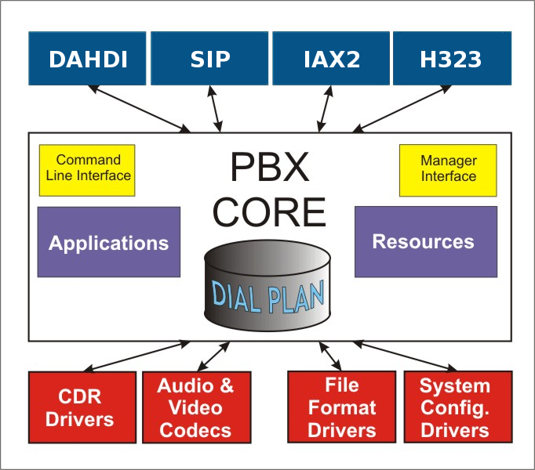
https://wiki.asterisk.org/wiki/display/AST/Asterisk+Architecture%2C+The+Big+Picture
Notes:
An overview of the Asterisk architecture. Notice how all modules converge in the dialplan, where they can be bridged together and actions can be executed.

Slide 12
Examples are better than theory
Read as: Let me just show off my home voice system

Slide 13
A scenario – what if I wanted to…
Have a call ring to the phone on my desk
Check to see if I’m logged into my instant messaging client
If yes
  Send me an IM with the caller ID of the incoming call
  Ring my IP phone
If no
  Send me an IM saying I missed a call (I’ll get it when I log in later)
  Give the caller the option to either:
    Ring through to my cell phone OR
    Leave a voicemail

Slide 14
Sounds a lot like coding, doesn’t it?

Slide 15
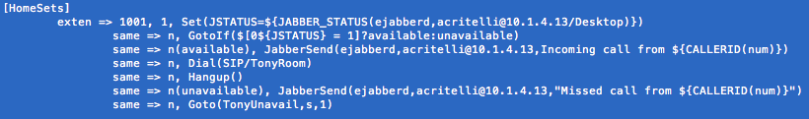
First, set a variable JSTATUS equal to my current Jabber IM status
If I’m logged into my Desktop, then go to “available” priority
Available: send me an IM with the incoming caller ID
Dial the IP phone at my desk
Hangup() used as a failsafe to indicate end of priority
Unavailable: send me an IM indicating that I’ve missed a call
Go to the “TonyUnavail” context, which is located somewhere else in the dialplan
Notes:
[HomeSets] defines a dialplan context. Contexts segment the dialplan, and we can pass calls between contexts. We can also tell modules to enter the dialplan at certain contexts. In this example, my SIP phones enter the dialplan in the HomeSets context. I defined this in /etc/asterisk/sip.conf.
Exten => 1001, 1, Set… is the first line here. “exten” just means extension. 1001 is the extension number. 1 is the priority of this step. Since this is the first step, it has priority 1. Then I call the set function to set a variable.
The same => n shorthand is used for the remainder of the steps. This prevents us from having to write exten => 1001, 2 for the second step and exten => 1001, 3 for the third step, etc. Although you could do gaps, such as 10, 20, 30, etc., this shorthand makes it much easier to insert and remove priorities. We also have some named priorities, such as n(unavailable).
I recommend consulting the Asterisk documentation for a better understanding of the GotoIf statement. The gist here is that if JSTATUS = 1, then go to the available priority. Otherwise, go to the unavailable priority.

Slide 16
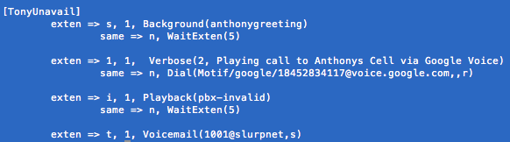
Play a greeting message and wait 5 seconds for input
1 is pressed: output some logging to console and connect the call to my cell via Google Voice
Invalid number is pressed: playback invalid choice and wait another 5 seconds
No input is provided: drop into voicemail
Notes:
Again, we see the [TonyUnavail] syntax for a dialplan context. The “i” extension is used for invalid input. The “t” extension is the timeout extension. Notice here how we have different extensions within the same context. This is normal, and most contexts will often have multiple extensions. Here, the extensions represent user input. For example, extension 1 is used to dial my cell phone by calling upon the Motif channel.

Slide 17
Conclusion
Asterisk is really cool
  It’s impossible to even scratch the surface in 20 minutes, but I hope you get excited about the possibilities
The architecture is sensible and not as scary as you may think
  Especially those with a more GUI-based telephony background
Pick up a copy of an Asterisk book and read the documentation
  Start learning! The hardest part is getting a phone. Hint: use a softphone for experimentation
Thanks for listening!
  This has been a really cool topic for me lately

Slide 18
Questions?
Anthony Critelli
@acritelli
www.acritelli.com
aac3771@rit.edu

