Slide 1
Implementing Voice over IP in Security Competitions
Anthony Critelli

Slide 2
Agenda
Competition overview
Intro to VoIP
Competition Voice Architecture
  Design
  Vulnerabilities
  Challenges
Results and future ideas
Application to the real world

Slide 3
About
B.S. Rochester Institute of Technology – 2014
  Networking & Systems Administration, summa
Designed, deployed, operated voice infrastructure for ISTS
CCNP, CWNA
Asterisk and VoIP enthusiast
Not artistic
  Sorry for the lack of checkerboard slide deck backgrounds

Slide 4
Competition Overview

Slide 5
What is ISTS?
Annual security competition at the Rochester Institute of Technology
Three teams
  Blue team – competitors
  Red team – professional security experts
  White team - infrastructure
Blue teams attack and defend against each other and red team
Notes:
ISTS is unique because of the ability for blue teams to attack each other
Red team featured professionals from Box, Mandiant, Raphael Mudge (developer of Cobalt Strike)

Slide 6
Competition Elements
IT services that must be defended
  HTTP/HTTPS, DNS, FTP, Email, SSH
Injects – additional tasks to be completed for points
  Ex: Implement webmail
Challenges
  Set up a Minecraft server on another team’s box, patch another team’s box, incident response challenges, build and implement your own cryptosystem

Slide 7
How does voice fit in?
One of the most important services offered by a company’s IT department
  Ever been around during a voice outage?
Isn’t usually well understood
  “Hey, you’re a sysadmin. Set up these phones.”
Protocols are vulnerable by default, configurations can be even more vulnerable
  More on this later
Notes:
Remember that the competition is aimed at college students. VoIP isn’t a commonly taught subject, and participants aren’t going to be entirely ready.
The other services (AD, SMTP, SSH, FTP, etc) are far more common and likely to be known

Slide 8
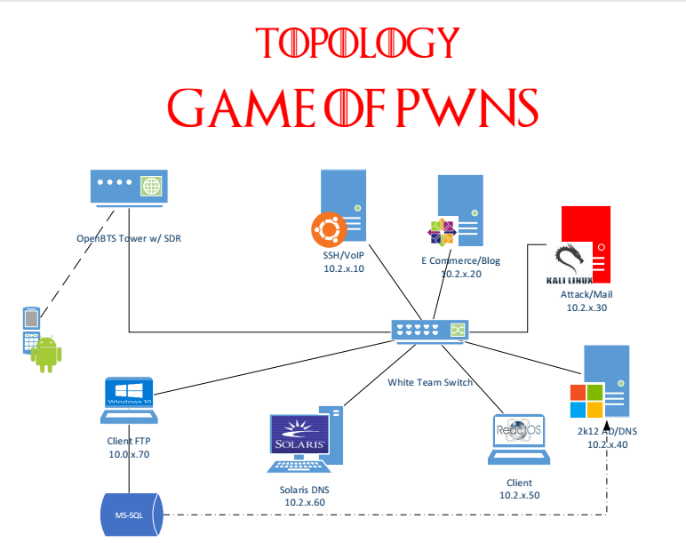
Notes:
This is the fake topology. Participants had to discover the real topology on game day.

Slide 9
Intro to VoIP

Slide 10
Protocols
Signaling and transport
Signaling: call setup, teardown, digit passing, etc.
  Commonly SIP or H.323 (UDP 5060 and TCP 1720)
Transport: the actual encoded audio or video
  Commonly RTP
  Use a particular codec: G.711 μ-law, a-law, iLBC, etc.
  UDP 1024 to 65535
Notes:
Most voice systems are moving toward SIP for signaling.
Text-based protocol format, very similar to HTTP makes it easier to troubleshoot.
SCCP and MGCP are other commonly seen protocols in Cisco environments
RTCP – Realtime transport control protocol
Sister protocol to RTP
Collects call statistics

Slide 11
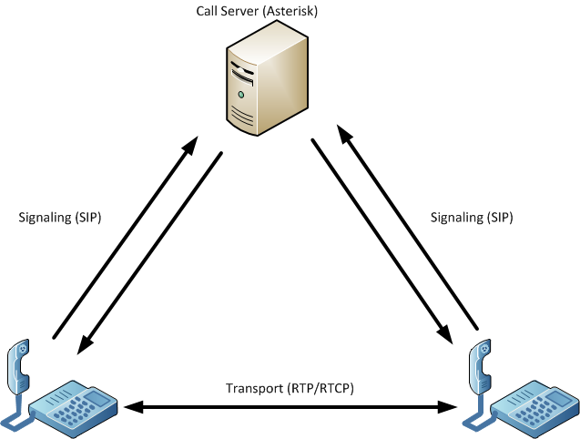
Notes:
Within an enterprise, a call server will handle the signaling between phones
Phones will then communicate directly using RTP and RTCP
Some statistics may still be collected by a central call server
The call server typically handles both the signaling and transport for calls leaving the enterprise
This is a very simple example. Voice topologies can be very complex, integrating many individual servers to accomplish various tasks (registration, signaling, statistics, etc.)

Slide 12
Vulnerabilities in VoIP Protocols
Plaintext – signaling and transport are usually unencrypted
Authentication – weak or nonexistent
Configuration tends to be challenging, especially in mixed vendor environments
  Security as a checkbox in vendor turnkey solutions, cry and drink heavily anywhere else
Notes:
Plaintext protocols make for easy eavesdropping and enumeration
SIP – eavesdrop and enumerate extensions on the network, calling pattern, digits, etc.
RTP – reconstruct entire calls, inject fake audio
SIP authentication is based on HTTP authentication, using MD5 hashing of a password with a bunch of known values
Security configuration can be very challenging. While the protocols may be standard, the vendor configurations are not. This creates difficulty for an IT service that we might want to be particularly customizable.

Slide 13
Vulnerabilities in VoIP Configuration
Misconfigured dialplans allow calling in unexpected ways
  An unauthenticated user agent placing arbitrary calls through a SIP proxy
  Use weakly secured voicemail or conference bridges to pivot through a call server and place calls to arbitrary destinations
This was our focus in ISTS
  Glaring, ridiculous vulnerabilities
Notes:
Poorly secured voicemail or conferences bridges with features enabled are a very common attack vector
Glaring vulnerabilities are:
Fun
Useful for learning how to recognize where to look for misconfigurations

Slide 14
VoIP Security Methods
Conceptually simple: authenticate and encrypt signaling and transport
  SIP/TLS – Use PKI to secure signaling
    Basically the same as HTTPS
    Note that this transitions SIP from UDP to TCP.
  Many different ways to secure RTP, making vendor interoperability challenging
    Why not use TLS?
Notes:
S/MIME can also be used to secure SIP, but there aren’t many implementations using it
There are two major approaches to securing RTP
Set up a key in the signaling protocol (ex: SDES in SIP)
Allow the media protocol to handle this (ex: ZRTP)
TLS isn’t usually used for media transport because we want a connectionless conversation for media

Slide 15
The Asterisk platform
“Asterisk is like a box of Legos for people who want to create communications applications.”
  www.asterisk.org
Communications applications
  Not just placing phone calls
Modular architecture – use what you need, don’t configure the rest
  We mainly just used the SIP channel driver in ISTS
Notes:
Asterisk is free and doesn’t limit us to the vendor specificity found in many other solutions
Can be installed on Linux, right alongside other services on a box

Slide 16
Asterisk – Important Configuration Files
/etc/asterisk – Location of all config files
sip.conf – configures the SIP channel driver
  SIP endpoints (phones)
  SIP security: SIP/TLS
extensions.conf – the “heart” of Asterisk
  Tells Asterisk how to handle incoming calls and messages
  A lot of applications to do different things. Including the execution of system commands.

Slide 17
Competition Voice Architecture

Slide 18
Design Basics
Each blue team receives an Asterisk server and peers with a central white team server
  White and red team phones proxy directly through the white team server
Hub and spoke topology
  White team hub, blue team spokes
  Simulates an actual real-world service provider topology
Each team has one physical phone
Notes:
Asterisk is installed on a regular box, not a dedicated server. It shares resources with other competition services.
Last year, voice was added as a sort of last minute “this would be cool” kind of thing
This year, we worked hard to really develop a voice architecture that matches (somewhat) a real-world voice system

Slide 19
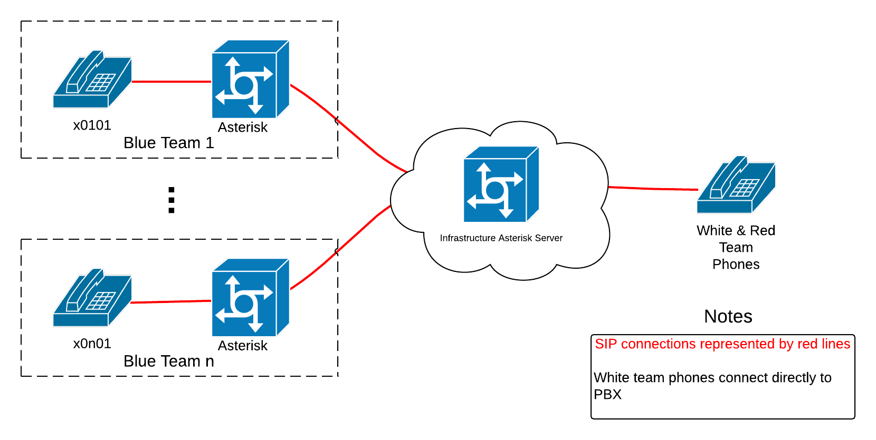

Slide 20
Vulnerabilities – Basic Premise
The boxes given to blue team in ISTS are usually Swiss cheese
  Learn to identify glaring vulnerabilities
Asterisk can execute system commands
  live_dangeorusly=yes in asterisk.conf
Set AST_USER=root in the init script, and you can have Asterisk run commands as root
Notes:
Examples of notable vulnerabilities
Using the “service” command also started a netcat listener
HTTP DELETE requests would do a bunch of things like dropping the firewall, starting a listener, resetting the root password

Slide 21
Three Main Vulnerabilities
One glaring vulnerability that could be identified and fixed
One that they had absolutely no control over
Other less obvious (and more awful) vulnerabilities that could still be fixed

Slide 22
Vulnerabilities
Calls from blue team to white team would result in the firewall being dropped
  Obvious and easy to fix, even without Asterisk experience
Every time blue team called white team for technical assistance, their calls could be randomly routed to red team
  Configuration on the white team PBX
  Outside the control of blue team
  Blue team actually gave their credentials to red team at least once
Notes:
Dropping the firewall simply involved a system call to “iptables –F” in the extensions.conf file
The second was a queue configuration on the white team PBX
Red team and white team were members of a queue for incoming calls
Music on hold was “Where the Hood At?”

Slide 23
Vulnerabilities
Each team had a hidden extension that launched a “System Management Hotline”
Anyone calling could manage the system using this menu
  Drop the firewall
  Backdoor SSH user
  Start telnet
  Start a netcat listener
All entries had to be in binary. Because we want you to be miserable.

Slide 24
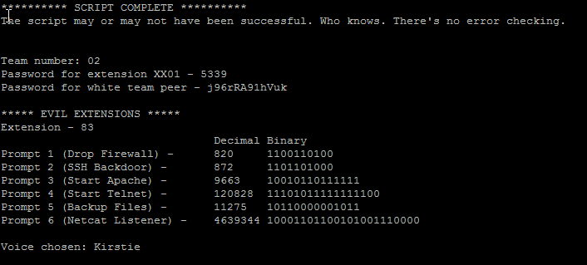

Slide 25
Vulnerability Implementation
These were all fairly simple to implement
  Just changes to /etc/asterisk/extensions.conf
  Evil menu was hidden with an include
  All inconspicuous file names
Scripted
  Each team had a unique menu
  Code available on Github (acritelli)
Difficult to detect without Asterisk experience
Notes:
Basically, all vulnerabilities involve dialplan code that executes system commands with root privileges
All were visible, but you had to know where to look

Slide 26
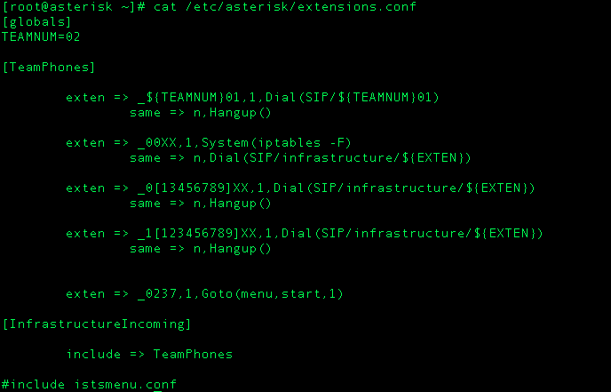

Slide 27
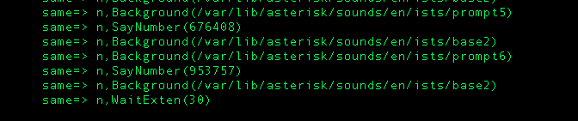

Slide 29
Why these vulnerabilities?
Notice that vulnerabilities focused on gross configuration issues
  Less focus on weakness of underlying VoIP protocols
  Why?
Misconfigured call routing and dial plans present a significant risk
  Especially with SIP, where we aren’t just dealing with numbers
Notes:
The goal was to raise awareness of the dangers of voice misconfiguration, especially when voice interfaces with other systems (or the underlying OS)
Consider the implications of a call server interacting with a database using values obtained from SIP packets. Injection attacks become possible.

Slide 30
Results and Future Ideas

Slide 31
Results - General
Voice setup was reasonably smooth
  Scripted process allowed for easy, unique configuration for each team
Voice infrastructure was rock solid
  306 total calls placed over the weekend
  No architectural issues or problems with peering
Only 2 teams remained peered by the end of the competition

Slide 32
Results - Vulnerabilities
By about 2PM on the first day, nobody had really noticed the vulnerabilities (except Red Team)
  So we made them a bit more obvious
Teams then began to correct them and/or use them against each other
This is very telling
  Voice concepts and software isn’t usually well understood

Slide 33
Future
Record and timestamp all calls
  Actually…
Collect call statistics
  Various programs exist for Asterisk
Implement better voice injects
  Secure calling, CDR collection, voicemail, unified communications, voice bucket list items, etc.
Make voice a scored service
Notes:
Overall, just look for ways to integrate voice more into the competition like any other service
Scoring voice would be unique, as it would more rely on polling the white team server and placing test calls

Slide 34
Future
More focus on protocol vulnerabilities
  Can be accomplished through challenges
Get a really cool sponsor to donate better phones
  And maybe softphones!
Unified Communications
  IM, video, voice, integration, synergy, communications enabled business practices, $buzzword

Slide 35
Application to the Real World

Slide 36
The Real World ™
How are any of these antics related to the real world?
Well, they demonstrate a few things
  Voice and communication isn’t always a well-understood IT service
  Voice applications can be seriously vulnerable
    Even if those vulnerabilities are less exciting than the ones we built
Notes:
How many programs teach voice systems?
How many voice systems take the “Here you go, sysadmin. Learn this technology.” approach.
Voice system fraud isn’t necessarily just about making international calls anymore
Although that is certainly an element
Users of voice systems have certain privacy expectations

Slide 37
Voice isn’t just voice anymore
We’re increasingly moving toward communication driven applications
  Call in your prescription, pay your bill via phone, manage accounts
Signaling packets are complex (They’re, you know. Packets.)
  500&SIP/itsp/14165551212
    README-SERIOUSLY.bestpractices.txt
Your voice system probably interfaces with other systems that contain sensitive data
Notes:
We need to ensure that the relationships between voice servers and other systems are secure
Including the transfer of data between those systems
The 500&SIP/itsp/14165551212 example would cause the SIP driver to place an outgoing call via the ITSP peer, which would allow arbitrary calls to be placed if this peer were available

Slide 38
Challenges
What challenges do these pose for professionals managing these systems?
  Voice system now presents the same attack surface as other publicly accessible applications
Is your voice system part of your security audit?
  The actual voice parts of the system, not just the server
  How about voice applications?

Slide 39
Protocol Security Implementation
How is voice protocol security being implemented in your enterprise?
  More difficult in mixed vendor environments
  Security as a checkbox? What protocols are actually being used?
  How is security handled in your voice connections to the outside world?
    A particularly important consideration when looking at SIP providers

Slide 40
Takeaways for competition organizers and competitors

Slide 41
Competition Organizers
Make voice an actual service in your competition
  Not just a way for teams to call yell at each other
Challenges/injects – securing VoIP, implementing other unified communications tech
Vulnerabilities – make them cool and hard to find

Slide 42
Competition Organizers
Try to integrate voice into the spirit of the competition
  We called pretending to be end users in need of tech support
Take advantage of the great FOSS for voice
  Asterisk, FreePBX, assorted softphones

Slide 43
Competitors
Get familiar with the voice platform that may be used in the competition
  Asterisk, FreePBX, etc.
  Phones often use predefined RTP ports
Be offensive
  Wardialing
  SIP scanning
  RTP injection
Learn!
  Voice and UC technology is of growing importance
Notes:
Voice and UC is also fun and can be done at home with freely available technology

Slide 44
Tools & Tactics
http://www.backtrack-linux.org/wiki/index.php/Pentesting_VOIP
Svwar – extension enumeration
VoIPong, Vomit, Wireshark – call capture and playback
Metasploit – scanning, enumeration, spoofing, and platform-specific exploits
Notes:
The provided link provides an excellent explanation of various tools, their usage, and the vulnerabilities that they exploit

Slide 45
Thank You
Security Practice and Research Student Association
  http://www.sparsa.org/
Information Security Talent Search 12
  http://ists.sparsa.org/
RIT Department of Computing Security
  http://www.rit.edu/gccis/computingsecurity/

Slide 46
Questions? Comments?
www.acritelli.com
critellia@gmail.com
@acritelli

