Slide 1
Introduction to Port-Based Network Access Control EAP, 802.1X, and RADIUS
Anthony Critelli

Slide 2
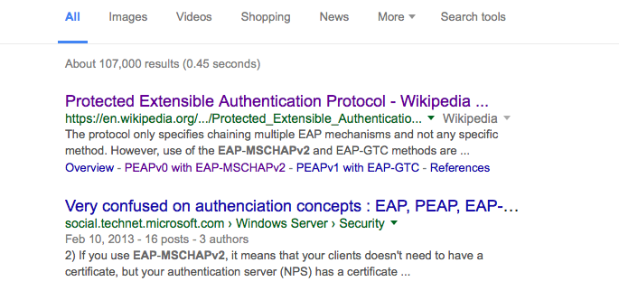
Many admins find this topic confusing
Notes:
I’ve always found that network administrators are intimidated and confused by 802.1x. Google seems to confirm that suspicion.

Slide 3
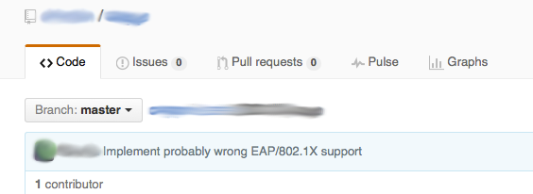
And implementers…
Notes:
I’m not actually sure if this implementation is wrong, but the comment was amusing either way.

Slide 4
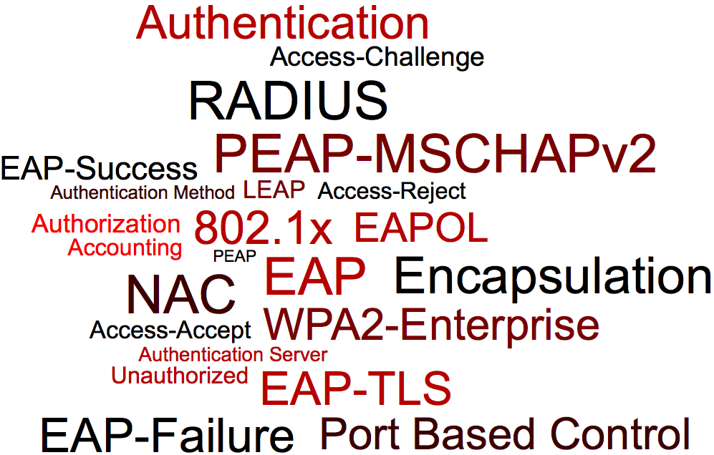
Notes:
One of the confusing things about port-based NAC is the sheer number of terms and protocols involved. As we’ll see, there are a lot of moving parts. However, they’re not hard once you’ve able to get them straight within your head.

Slide 5
High Level Goals

Slide 6
Encapsulation
Let’s quickly recap (heh) encapsulation
Example: DNS
DNS Data encapsulated inside UDP datagram
UDP datagram encapsulated inside IP packet
IP packet encapsulated inside Ethernet frame
We’re just adding adding headers to data
Like placing a letter in an envelope
Notes:
Encapsulation plays a central role within the protocol stack necessary for port-based NAC. We’ll see a logical EAP conversation between two endpoints is encapsulated within two different protocols, depending on where the conversation is taking place within our topology.

Slide 7
What are we trying to do?
Permit or deny network access to devices
Not necessarily users
Wired and wireless
Make this work across the network
Wired switches
Wireless access points
Ability to abstract some of this functionality from the devices themselves
Notes:
While this authentication is often user-based (think using your AD credentials to sign onto the WiFi), it doesn’t have to be. Imagine a public library. The library probably doesn’t care who uses the public use computers, but it may care that only their authorized computers are allowed onto the network. They may use certificates on those machines to ensure that only library assets can be plugged in, but they don’t care who the end-user is.
We want to abstract these goals from the actual switches and access points in the network. They shouldn’t need to be concerned with how the authentication works. They should only care whether or not they are permitting access to a device.

Slide 8
1000 foot view
A node (supplicant) connects to a network device (authenticator)
The authenticator tunnels traffic between the node (supplicant) and an authentication server (AS)
The authentication server decides if network access will be granted
The network device (authenticator) permits or denies network access
Notes:
Think of a common scenario: your laptop associating with Active Directory credentials to the wireless network.
Your laptop is the supplicant. More specifically, the 802.1x and EAP software implementation on your laptop is the supplicant.
The access point is the authenticator.
The RADIUS server in the backend (invisible to you) is the authentication server (AS).

Slide 9
Brief look at protocols
IEEE 802.1X – between supplicant and authenticator
RADIUS – between authenticator and authentication server
Remote Authentication Dial-In User Service
EAP – logical conversation between supplicant and authentication server
Extensible authentication protocol
Tunneled by authenticator

Slide 10
Notes:
The 802.1x conversation occurs between the supplicant and authenticator.
The RADIUS conversation occurs between the authenticator and the AS.
The EAP conversation is a logical conversation between the supplicant and AS, encapsulated in 802.1x or RADIUS depending on where in the topology we are looking.

Slide 11
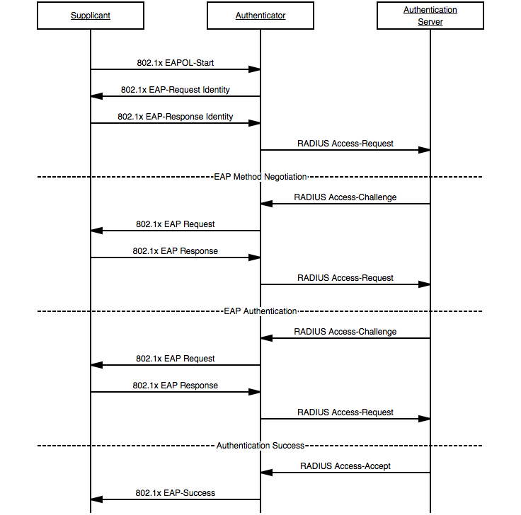
Notes:
This ladder diagram shows the entirety of the conversation between the supplicant, authenticator, and authentication server.

Slide 12
Housekeeping

Slide 13
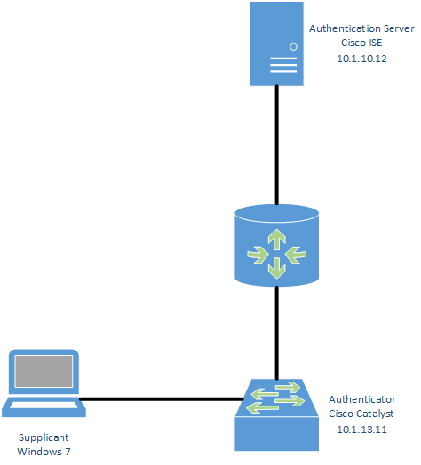
Lab Topology

Slide 14
Housekeeping
Windows client with wired 802.1x for packet captures in this presentation
Windows is annoying to set up in a lab environment
Need to manually enable the Wired AutoConfig service
Need to allow ignore self-signed certificate on AS
Only do this in a lab environment.
Need to dig into 4 million nested menus to specify credentials
Probably some other stuff that I’m forgetting
Not hard, just annoying (for labs)
Notes:
Google around for instructions on how to enable wired 802.1x on Windows clients. It’s not difficult, just annoying.

Slide 15
EAP Let’s get logical

Slide 16
Notes:
We’ll be talking about the logical conversation here between our supplicant and the authentication server. Remember, this traffic is tunneled by the authenticator, which is a switch in this topology. We’ll take a closer look at that tunneling later.

Slide 17
Extensible Authentication Protocol
RFC 3748
Provides an authentication framework
Multiple authentication methods are supported and defined, typically under additional RFCs
Extensible – vendors can pick and choose the protocols that they support
Defines message formats, not specific authentication protocols
Hence, an authentication framework
Notes:
Frameworks provide a foundation to build additional functionality on top of. New authentication methods can easily be integrated on top of EAP. Some of these standards are open (EAP TLS, RFC 5216), and others are proprietary (Cisco’s LEAP)

Slide 18
The logical conversation
A logical conversation takes place between the supplicant and the authentication server (AS)
The supplicant and AS don’t talk directly. The authenticator handles the communication
Again, allows for the protocol to be fairly lightweight
Switches and APs (expensive) don’t need to relearn a new protocol every time a shiny new authentication method is introduced or an old method is deprecated
Vendors can even introduce their own methods
Cisco’s Lightweight EAP (LEAP)
Notes:
Network nodes (such as your laptop or an authentication server in the data center) are free to utilize those methods that they see fit. The devices granting network access (switches, access points, etc) don’t have to worry about the fine-grained details of how the authentication works.

Slide 19
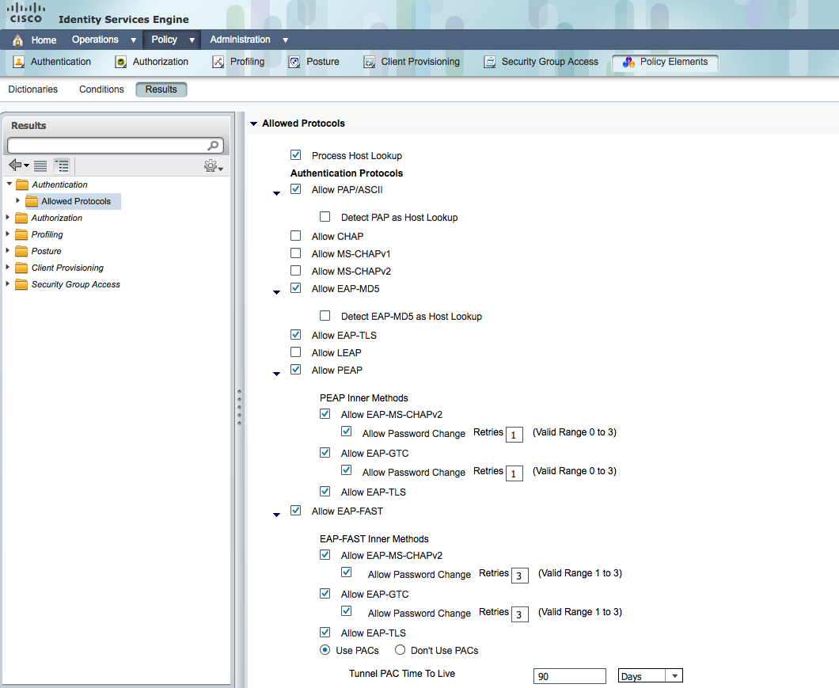
Notes:
Here we can see a screenshot of available EAP methods within Cisco’s Identity Services Engine (ISE). ISE was used for this presentation’s topology as the authentication server. ISE is extremely powerful, and possesses a wide variety of features for securing a network.

Slide 20
Two common EAP methods
PEAP-MSCHAPv2
Challenge authentication based
Username and password
EAP-TLS
Certificate based

Slide 21
EAP-MSCHAPv2
Older Microsoft authentication method
Generally, MSCHAPv2 not considered secure
Multiple weaknesses have been found
Encapsulate it within PEAP (PEAP-MSCHAPv2)
Protected EAP
EAP encapsulated within TLS
Weaknesses inherent in MSCHAPv2 are less problematic
Server needs a certificate
Typically the method you’ll see when authenticating with AD credentials
Notes:
https://technet.microsoft.com/en-us/library/security/2743314.aspx
Basically, we don’t want MSCHAPv2 to run in cleartext, so we encapsulate it within TLS to create PEAP. Remember, lots of encapsulation going on here. We now have our logical EAP conversation (already encapsulated within 802.1x or RADIUS, as we’ll see) encapsulated within another layer of TLS.

Slide 22
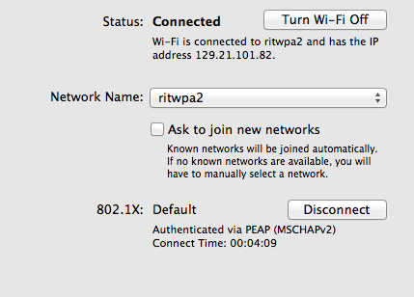
Notes:
We authenticate to ritwpa2 with AD credentials, so it makes sense that we’d be using PEAP-MSCHAPv2.

Slide 23
EAP-TLS
Uses certificates
The device requesting network access presents its certificate to the AS
Most implementations require network devices (PCs, mobile devices, etc.) to have certificates
Not an actual requirement of the RFC, but typical
Presents challenges for BYOD
Common in wireless environments
Notes:
EAP-TLS is fairly common in wireless deployments. Often, a company will require some kind of initial “enrollment” of a new device. This process will automate the process of assigning the device a certificate and getting it onto the network, requiring no further user intervention.
This method is often administratively expensive, as it requires a PKI and administrator skillsets that aren’t often found in smaller environments.
The implementation requirement for network devices to have certificates has been criticized as presenting a barrier to adoption of secure “open” hotspots. Theoretically, a certificate could only be required on the NAS, and any device would be allowed to authenticate. This could bring a measure of security to otherwise open hotspots, as they wouldn’t necessarily care about the devices connecting to them. However, they would be able to provide security services.

Slide 24
802.1X

Slide 26
Overview
IEEE standard for encapsulating EAP over LAN
EAPoL
We’re encapsulating our EAP messages for transport over a LAN medium (Ethernet, 802.11)
The 802.1X conversation is between the supplicant and the authenticator
Example: Your PC and the switch that you plug into
Notes:
Remember the logical conversation. This is where we really start to see actual packets. The logical EAP conversation will be encapsulated within 802.1x frames between the supplicant and authenticator.

Slide 27
Port States
Uncontrolled
Port begins in this state
Only 802.1x traffic is allowed
Remember, communication at IP layer is unnecessary right now
We don’t even need to allow DHCP
Controlled
Full access to network services
Controlled traffic is allowed once the port is authorized
These states work both ways
A client may want the network to authenticate itself also before transmitting data
Notes:
It’s important to understand that IP-layer communication is used at all by the supplicant during the authentication process. This is because the supplicant is communicating with the authenticator at layer 2.

Slide 28
Notes:
Visual representation of controlled and uncontrolled logical ports. Only 802.1x traffic is allowed until the supplicant is placed into an authorized state, which allows controlled traffic to flow.

Slide 29
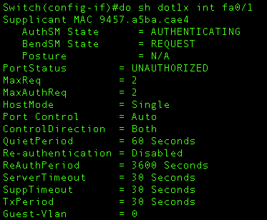
Initialization
Port is enabled and set to unauthorized
Only 802.1x traffic
Notes:
Switch output shows that this port is currently in the unauthorized state. We can also see that a supplicant is currently authenticating but has not yet been granted access. At this point, only 802.1x traffic will flow.

Slide 30
Initiation
One of two things happens:
Supplicant sends EAPOL-Start or
Authenticator sends EAP-Request Identity
Sent to 01:80:c2:00:00:03
Nearest non-TPMR Bridge Group address
Notes:
TPMR means “two port MAC relay” From my limited Googling around, this was a largely unsuccessful standard to implement a simpler Ethernet bridge.

Slide 31
EAPOL-Start
Notes:
The supplicant indicates that it is ready to begin the authentication process.
Ignore the VSS-Monitoring trailer, it’s related to the SPAN port that I setup on the switch.

Slide 32
EAP-Request Identity
Notes:
The authenticator asks for the identity of the supplicant. Notice that the source MAC address is the Cisco switch.

Slide 33
Initiation continued
Supplicant sends EAP-Response Identity
The authenticator encapsulates and sends to AS
Notes:
Remember, the authenticator isn’t really concerned with the supplicant’s identity. That information is part of the logical conversation between the supplicant and the authentication server. We’ll take a closer look at how this is encapsulated and sent to the AS later.

Slide 34
EAP-Response Identity
Notes:
The supplicant provides its identity to the authenticator. In this case, we can see the username is “user”

Slide 35
EAP Negotiation
The AS and the supplicant negotiate an EAP method using Requests and Responses
Remember, this conversation is logical
The requests and responses are encapsulated
The supplicant/authenticator conversation uses 802.1x
The authenticator/AS conversation uses RADIUS
The server may request a method that the client doesn’t support
The client can suggest an alternative method
Notes:
We’ll take a closer look at RADIUS soon.

Slide 37
Notes:
We can see that the authentication server is requesting EAP-TLS.

Slide 38
Notes:
However, the supplicant denies this request. Instead, it proposes using PEAP.

Slide 39
Authentication
The logical EAP conversation is tunneled via 802.1x requests and responses
The length of this conversation depends on the EAP method in use
Ends with a success or failure
Port is placed into an authorized or unauthorized state
Controlled traffic (non-802.1x packets) can now flow
Client can send an EAPOL-Logoff when complete
Notes:
Once again, it’s the job of the authenticator to permit or deny network traffic. It allows the authentication server to perform the heavy lifting of determining whether or not a device should be allowed to communicate on the network.

Slide 40
Authentication exchange
Notes:
We can see that the authentication exchange involves multiple EAP requests and responses. The amount of traffic depends on the authentication method being used. At the end of the exchange, we can see a Success message, and then we see normal traffic (DHCP) flow normally.

Slide 41
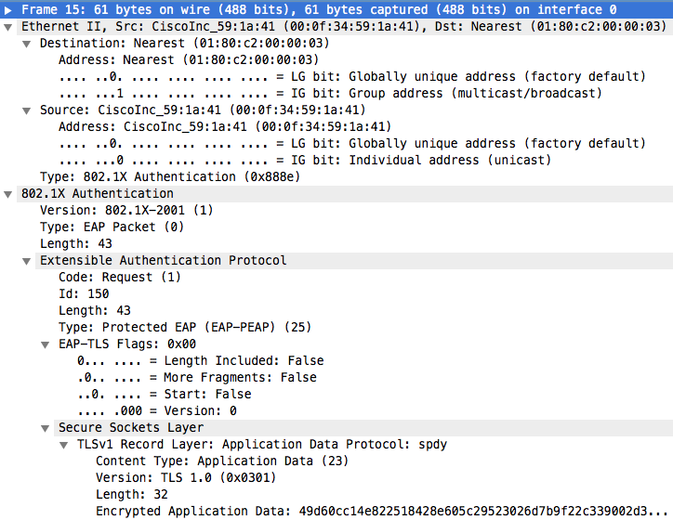
Notes:
This is a sample EAP-Request packet from the authentication exchange.

Slide 42
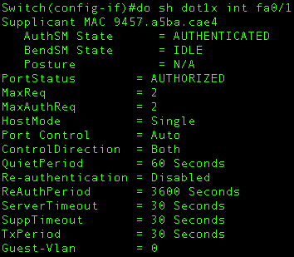
Notes:
Finally, we can see that the status of the switch port is authorized. Controlled traffic is now allowed to flow.

Slide 43
RADIUS

Slide 45
Overview
Remote Authentication Dial-in User Service
Provides AAA services
Authentication, authorization, accounting
RFC 2865 and RFC 2866
RFC 2865 – authentication (Authc) and authorization (Authz)
RFC 2866 – accounting
We’ll focus on authentication
Confirming that someone is who they say they are
UDP port 1812
Notes:
Command authorization is common in networks using RADIUS to ensure that a user has the permission to execute certain commands. Accounting typically involves logging of session details.
Notice that RADIUS uses UDP port 1812. We previously established that the supplicant doesn’t have an IP address. This is where the tunneling performed by the authenticator comes into play.

Slide 46
Protocol Operation
Logical EAP conversation is tunneled between the authenticator and AS using RADIUS Access-Request and Access-Challenge methods
Looking at the packets, we see the same EAP traffic as before
Just encapsulated inside RADIUS instead of 802.1x
Process ends with an Access-Accept or Access-Reject
Notes:
The Access-Accept or Access-Reject tells the authenticator whether or not it should permit controlled traffic from the attached device.

Slide 47
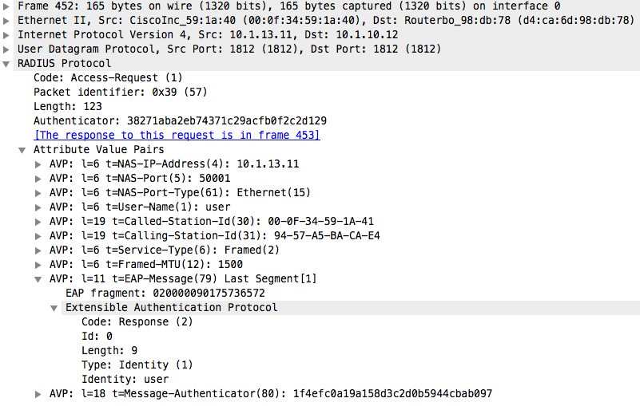
Initial Access-Request
Notes:
Notice that we can see the EAP-Response Identity from the EAPOL conversation, but this time it is encapsulated inside RADIUS instead of 802.1x. There are also other fields that can be used to determine network access, such as the NAS-Port-Type, which will typically be Ethernet or 802.11.

Slide 48
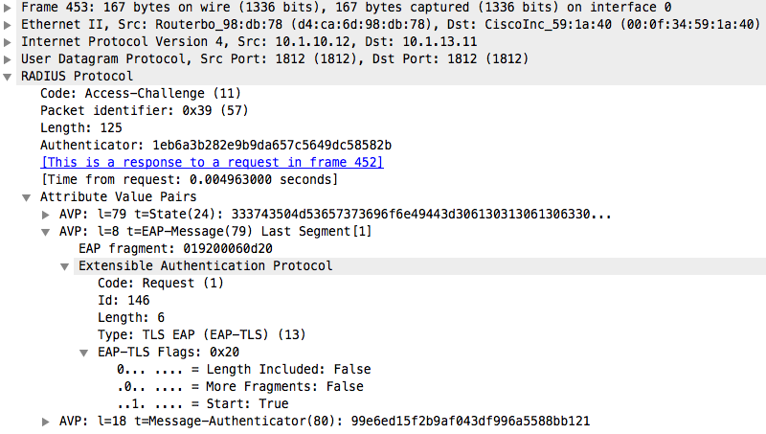
EAP Negotiation
Notes:
Once again, we see the same EAP-Request with EAP-TLS.

Slide 49
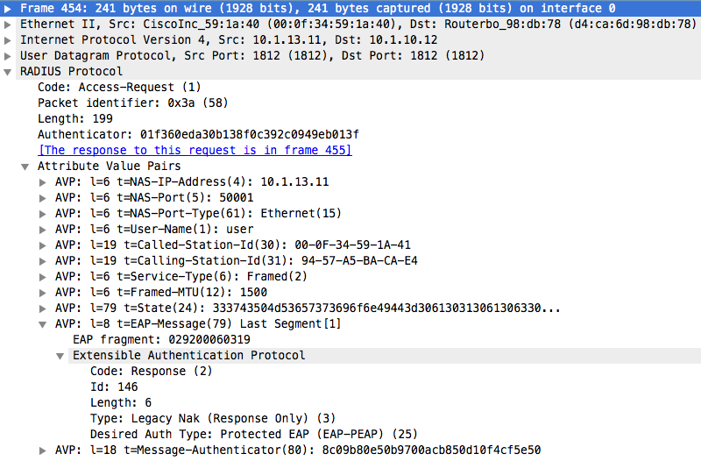
EAP Negotiation
Notes:
And once again, the supplicant rejects this authentication method, instead requesting PEAP.

Slide 50
EAP Exchange
Encapsulated within Access-Request and Access-Challenge packets
Length depends on authentication method
Ends with a RADIUS Access-Accept or Access-Reject
Notes:
We see a conversation that is essentially identical to the 802.1x conversation, terminating with a RADIUS Access-Accept.

Slide 51
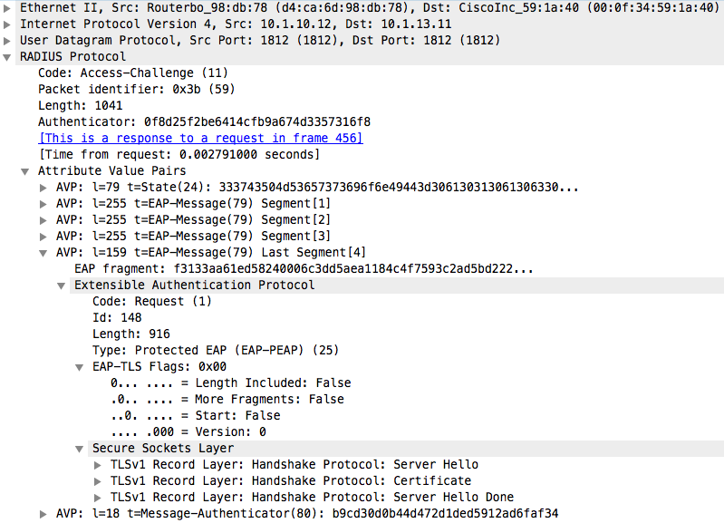
EAP within Access-Challenge
Notes:
We can see a sample message from the authentication exchange. The PEAP conversation (EAP within TLS) is encapsulated within a RADIUS packet.

Slide 52
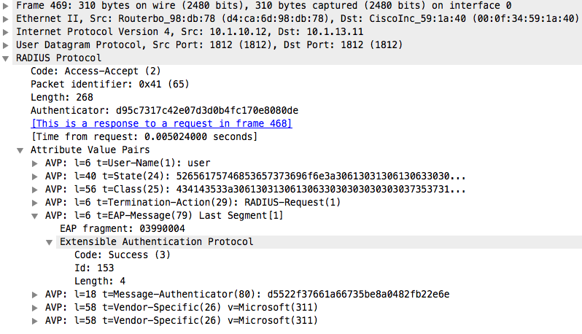
Access-Accept
Notes:
The Access-Accept tells the authenticator to allow the attached device to communicate on the network.

Slide 53
Tying it all together

Slide 54
Notes:
This ladder diagram shows the entirety of the conversation between the supplicant, authenticator, and authentication server.

Slide 55
Conclusion
Port-Based NAC provides (or denies) network access to devices
Uses a combination of EAP, 802.1x, and RADIUS
Lots of encapsulation
EAP provides a framework
Authentication methods are built on top of it
Most importantly: it’s not that confusing once you understand the packet and protocol flow

Slide 56
Questions? Comments?
www.acritelli.com
critellia@gmail.com

