Slide 1
Introduction to Ansible
Anthony Critelli

Slide 2
But first:
There’s a live demo
Sign up for info at: demo.acritelli.com
If you’re already pretty comfortable with Ansible, please leave room for others
  I only have 20 demos

Slide 3
Overview

Slide 4
Automation and Config Management
Need ways to quickly and consistently deploy infrastructure
Back in the day: bash, Perl scripts, and duct tape
Today: standard tools, such as Puppet, Chef, Ansible, AWS CloudFormation, etc.
Abstract away the underlying commands
  If the syntax of yum were to suddenly change, you wouldn’t have to update all of your scripts
Manage the config – check into a repo, code review, etc.

Slide 5
Infrastructure as Code
Everything about a piece of infrastructure is codified
  In a human-readable format
Easier to maintain state
Easier to backup/recover
  Instead of backing up an entire VM, why not just back up the end-state configuration?
Infrastructure code can be peer-reviewed, checked into repositories, etc.
This continues to get easier as more services expose an API to administrators

Slide 6
What is Ansible?
“Simple IT Automation”
  Very easy to get up and running
  Simple architecture – just a control machine for basic deployments
Agentless
  Works over SSH
Push-model by default
  Ansible server connects to managed hosts and executes commands

Slide 7
YAML
YAML Ain’t Markup Language (YAML)
Data serialization language
Simple and straightforward syntax
Used for expressing Ansible playbooks

Slide 8
A quick note about documentation
The Ansible docs are great
  Intro tutorials
  Module documentation
  Lots of examples
Also read the best practices
  Particularly useful for larger projects

Slide 9
Technical Details

Slide 10
So, how does it work?
Playbooks are executed against hosts (inventory)
The playbooks contain a series of tasks
Tasks are units of work/configuration policy
  Use modules to accomplish their goal
Modules are “reusable, standalone scripts”
  Ex: The “get_url” module downloads a file via HTTP, HTTPS, or FTP and places it on a host

Slide 11
Inventory
Hosts are defined in an inventory file
  INI-like format
  /etc/ansible/hosts
You can group hosts together
  Define all of your webservers under one header
Hosts or groups of hosts can have their own variables
  Ex: We want all servers in our NY datacenter to use a certain syslog server
Dynamic inventory – automatically pull inventory from an external source, such as AWS

Slide 12
Sample inventory
[webservers]
10.100.0.101
web02.example.com
[databases]
db-[a:f].example.com
[rochester:swillburg]
swillserver[01:20].rochester.example.com

Slide 13
Variables
Variables can be defined in MANY places
  The right place depends on your environment
  But always try to write reusable code
Written in YAML syntax
Single variables, lists, dictionaries

Slide 14
Variable examples
#Single variable
webdirectory: /var/www/html/mysite/
#List
users:
- bob
- alice
#Dictionary
server_params:
max_connections: 10
port: 8080

Slide 15
Facts
When Ansible connects to a remote host, it collects information about the host
  Obtained via the “setup” module
  Hostname, distro, etc.
This information can be accessed in your playbooks
Setup module can be turned off
  Benefits for scalability when you don’t need a system’s facts

Slide 16
Jinja2
Ansible supports templating with Jinja2
Allows you to reference variables in file templates, which are then placed on remote hosts
  Example: specify certain ntp servers (variable) for hosts in a specific region (rochester:swillburg)

Slide 17
Let’s take a look at a task
- name: install ntp
yum: pkg=ntp state=present
become: yes #Executes task as root user

Slide 18
Handlers
Tasks that are executed when a module changes the system
  Restart a service when a config file is changed
Only executed once when called, no matter how many modules call a handler
tasks:
- name: disable password login
lineinfile: path=/etc/ssh/sshd_config line=“PasswordAuthentication no”
notify: restart ssh
handlers:
- name: restart ssh
service: name=sshd state=restarted

Slide 19
Tags
Tags can also be used to further classify plays and tasks
  For example: maybe there’s a set of tasks that you want to run separately from the rest of the playbook
  Example: updating packages and rotating keys
    Might be in a larger play of many tasks
    Only need to perform full system update and update SSH keys sometimes
Tags can be specified when running Ansible

Slide 20
A simple playbook
- hosts: all
vars:
user: donald
tasks:
- name: create user
user: name={{ user }} createhome=yes
- name: update packages
yum: name=* state=latest

Slide 21
Cool, so how do we call a playbook?
ansible-playbook -i <hostsFile> <playbookName>
Executes as the user who is calling the playbook on the control machine
  Unless you specify a different user in the playbook itself

Slide 22
Roles
Best practices indicate that roles should be used in larger deployments
Roles specify a special file hierarchy that abstracts imports
  For example: you might have a webserver role
  The webserver role, and all of its supporting files (variables, templates, etc.) are stored in a webserver folder
  Now, you can just specify that a host has the webserver role
Allow you to begin describing your infrastructure in a more sensible way
  I want web01.example.com to be a webserver
  All webservers should also be “common servers”

Slide 23
Personal Tips
Don’t get 100% hung up on best practices
  The Ansible docs even say that the best architecture is one that works for you
  But: don’t use that as free license to ignore best practices
If you’re stuck, write your script as one large playbook and then break it out later
Tag things
  Great way to organize tasks
  Good for testing (i.e. tag a set of new tasks that you’re adding to your playbook, then only run those tasks)

Slide 24
Pre-deployment Housekeeping

Slide 25
Prepping an Ansible control server
Install Ansible
  Available through many repositories
  For RHEL/CentOS: available through EPEL
Create an Ansible user
  Username can be whatever, but I typically call it “ansible”
Create an SSH key for the Ansible user

Slide 26
Prepping a server for Ansible
Create the Ansible user
Give the user passwordless sudo
  Or whatever methods are necessary to ensure that the Ansible user can execute the appropriate commands over SSH
Copy the SSH public key for the Ansible user
  Password authentication supported but we usually use keys

Slide 27
Let’s do it live

Slide 28
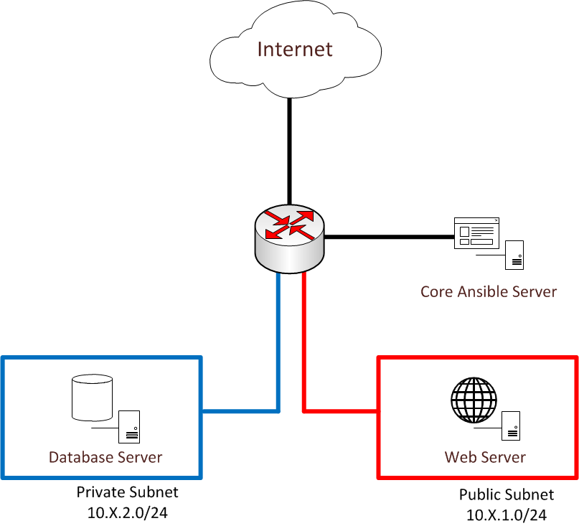
Demo topology

Slide 29
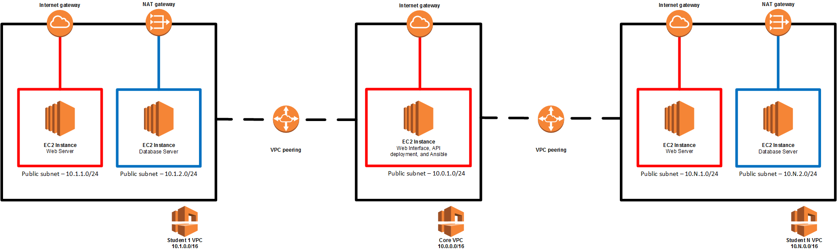
Actual AWS Topology

Slide 30
Demo Code
https://github.com/acritelli/NextHopAnsibleDemo

Slide 31
Questions? Comments?
www.acritelli.com
critellia@gmail.com

