Slide 1
VMware Virtualized Networking
Anthony Critelli
10/24/2017
RIT NextHop

Slide 2
Agenda/Goals
Discuss some of the networking challenges in a modern virtual environment
Introduce generalized solutions
Provide an overview of what VMware is doing
Hopefully get everyone interested

Slide 3
Challenges
What problems are we actually trying to solve?

Slide 4
How did we configure networks 20 years ago?

Slide 5
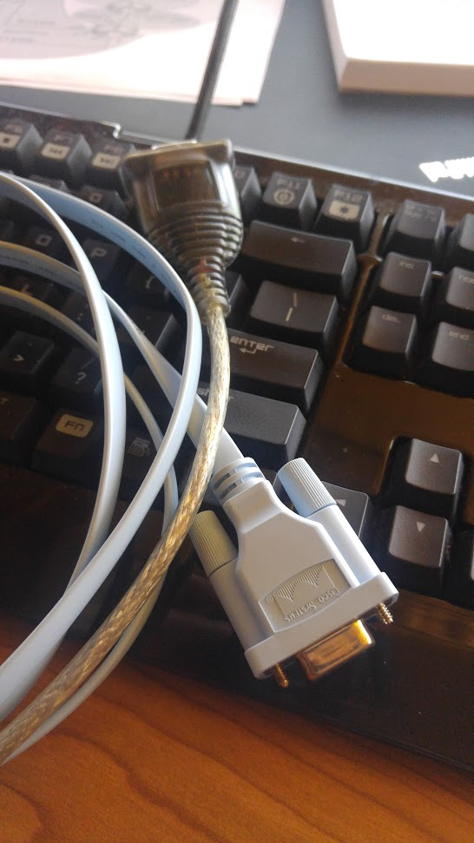
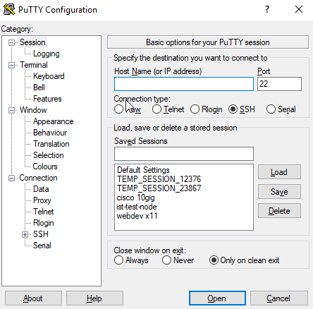
The olden days

Slide 6
How do we configure networks now?

Slide 7
We’ve come a long way
Notes:
The way we do networking has fundamentally changed very little over the years. This is particularly true of the management and control planes. The data plane has seen various improvements, but we typically still manage our routers and switches via the CLI. Automation has been hard, because API support has been lackluster, although this is gaining some traction.

Slide 8
Why is this a problem?
We can’t adjust to change easily
Adding a new logical segment can take time and coordination across multiple teams
The network can be opaque
No “single pane of glass” or easy way for others to see how things are set up
This approach is error-prone
switchport trunk allowed vlan 10
Whoops, I forgot the “add” keyword
Example: several developers want identical, multi-tiered application networks to perform testing and development on
Notes:
These aren’t challenges that all organizations face. More static organizations may have no problem with the lead time that often accompanies any sort of network change. However, other organizations can’t afford to wait.
The network being viewed as “black magic” by traditional sysadmins and developers is a good representation of this opaqueness. Network complexity can be very problematic.

Slide 9
Current Topology
Notes:
A typical topology will have a ton of VLANs on the physical fabric with trunks connecting the hypervisor hosts. A virtual switch on the host will tie all of these VLANs to port groups, and then VMs connect to those port groups.
There are a number of potential issues with this:
Adding another isolated network must be done in several places
It’s not easily automated
We may need some way to synchronize VLANs across our physical fabric (#NeverVTP)
Depending on the setup, we may not be able to easily accomplish some goals, such as overlapping IP subnets for dev environments.

Slide 10
How do I fulfill the developer’s request?
Ask the network team to add a VLAN
Must be added on each switch in network (never use VTP)
Must be added to uplinks
Add a port group
Add VMs to the correct port group
Maybe re-architect the network if hosts are on different subnets
This isn’t hard, but it’s also not dynamic and can result in errors
Notes:
This is not very dynamic. We can’t easily automate this process because there are so many pieces. Some pieces may not even support automation (i.e. traditional networking gear without API support). Additionally, each step is prone to an error that could impact other workloads.

Slide 11
How do I want to fulfill the developer’s request?
Notes:
It would be nice if I could rapidly create a new network without thinking about all of that previously mentioned complexity.

Slide 12
What technologies do we use?
This sounds cool, but how do we actually do it?

Slide 13
Overlay Networking
Create a logical network between the hosts
We don’t care about how the packets get between the hosts
Well…Joel Spolsky’s Law of Leaky Abstractions still applies
Hosts could be on different networks, in different datacenters, etc.
As long as they can talk, their virtual switches can talk
We need some kind of header/protocol to handle this
Notes:
The Law of Leaky Abstractions: https://www.joelonsoftware.com/2002/11/11/the-law-of-leaky-abstractions/
A good example of a leaky abstraction: trying to span a layer 2 network across geographically-dispersed datacenters is going to introduce latency due to the underlying transport. Stretched layer 2 is also generally a bad idea, although there’s often some debate about this among networking professionals. It’s also usually a band-aid to compensate for applications with bad architectures.

Slide 14
Overlays
This can sometimes be hard to wrap our head around
Simple example: VPN
PC1 and PC2 have no idea of the routers/network in between
They just think they’re on one logical network segment: 10.1.1.0/24
Notes:
Overlay networking can be hard to initially understand, and a VPN provides a simple example. The two computers think they’re on the same logical network. There’s an overlay working here (i.e. IPSEC or $vpnTunnelProtocolOfChoice). These hosts don’t know about the complexity of the underlying network. The overlay protocol doesn’t even need to care about the underlying network. For example: IPSEC just needs two tunnel endpoint IPs to be reachable to each other. IPSEC doesn’t care if these are 2 routers or 10 routers apart.

Slide 15
VXLAN
Virtual eXtensible LAN
RFC 7348
Really, it’s pretty simple:
Create a virtual network with an ID (VXLAN Network Identifier/VNI)
Add a header with that ID
Send the encapsulated traffic between hosts (VXLAN Tunnel Endpoint/VTEP)
Notes:
Basically, the diagram on the right shows a simple architecture. Two hosts are connected to each other over a layer 3 network. Each host is a VTEP (VXLAN tunnel endpoint). We can see that each VM is in its own isolated VXLAN network, as identified by the VNI (VXLAN Network Identifier). It’s sort of like using VLANs to isolated traffic, but instead we’re using VXLANs.

Slide 16
What does the packet look like?
Notes:
OK, this might look a little complicated, but let’s break it down by first looking at the original Ethernet frame. The original Ethernet frame is just the frame that would normally be sent between two virtual machines. Let’s say VM1 on ESX1 wants to talk to VM2 on ESX2. The original Ethernet frame is just the frame that would normally be sent between these two VMs.
We append a VXLAN header to this Ethernet frame. Inside of the VXLAN header, we have the VNI that uniquely identifies the virtual network.
The VXLAN header is encapsulated inside of UDP, with a source that is calculated via a hash of inner packet fields (RFC recommendation).
Then, we just have a standard Ethernet/IP header. In our example, this would be a source of ESX1 with a destination of ESX2.
The packet is then forwarded from ESX1 to ESX2. ESX2 receives it and strips off the outer Ethernet/IP header as normal. It looks at the VXLAN VNI and sees that this is destined for a specific virtual network. It then places the traffic onto this virtual network.

Slide 17
From old to new
Notes:
Our physical underlay network is now far more simple. A simple cluster in a single datacenter could just have hosts on one subnet/VLAN. There’s no need for hundreds of VLANs on our physical fabric.
Of course, the image above assumes that hosts are on the same subnet. They don’t have to be. VXLAN can communicate across layer 3 boundaries.

Slide 18
Lots of considerations
New headers = larger packets
MTU concerns
How do we handle ARP/broadcast/multicast traffic
Different implementations do different things
We could use a logically central controller
Intercept ARP requests and provide responses
We could use multicast: send traffic out to all VTEPs with guests in the associated logical network
Many vendors are doing different things that incorporate VXLAN in some way
Notes:
MTU size may not be as much of a concern if you own the entire underlay network (i.e. within a datacenter), but it’s important to be aware of it in case you don’t (i.e. over a WAN).
The method of handling broadcast/multicast traffic can vary by vendor. We could multicast the multicast by sending it out to every VTEP, and then the VTEPs distribute it to the appropriate virtual network. Or it could be intercepted by a controller and a forwarding decision could be made by a logically centralized control plane.

Slide 19
VMware
What are they doing?

Slide 20
NSX
NSX is VMware‘s network virtualization solution
Tons of different components
More on that in a second
Integration with vCenter
NSX-T and NSX-V
NSX-V is for use with vCenter, and is the classical way of doing NSX
NSX-T is very new (announced officially at VMworld 2017) and is multi-cloud
Control your network for AWS, on-prem, etc. all from one central management plane
This discussion will focus on NSX-V

Slide 21
Features – there’s a lot of them
Distributed Firewall
Microsegmentation
Logical switch
VXLAN and logical network segmentation
Distributed Logical Router
A logical router that can span across all of your VMware hosts
Solves traffic hairpinning – routed traffic between two VMs on the same host never leaves the host
Traditional routing protocols to peer your VMware environment with the outside world
NSX Edge
Load balancing, VPN services, NAT, DHCP, etc.
Notes:
Essentially, most of the standard features that you would want out of a traditional network can often be provided by NSX. Not all of them, but a lot of them.

Slide 22
Distributed Firewall (DFW)
A bit of a gateway drug into NSX
Single place to control firewall rules that take effect at the hypervisor level before the virtual NIC
Can cut out the host firewall
Can dynamically control VM-to-VM communication
Even on the same network!
No need to draw security boundaries on subnet boundaries
Automatically place VMs into groups based on criteria and apply policy
Microsegmentation
Very granular policies about what types of communication are allowed
Third-party integrations
Notes:
We’re always trying to come up with better firewall management methods. Traditionally, we have separated things by Layer 3 boundaries (different subnets) and then have firewalls between them. However, this can be limiting. Moving a system between subnets is difficult and error-prone. We can’t block traffic on the same network. We often don’t have “single pane of glass” visibility into our entire firewall strategy.
NSX can also integrate third-party solutions via its API to make forwarding decisions. For example: an IDS could detect an intrusion and automatically quarantine a VM. This is done at the hypervisor level, so it’s about as good as you can get.

Slide 23
DFW
Notes:
Sitting between our Guest VM and the hypervisor host are a number of “Slots” that can be filled with functionality. The distributed firewall sits in one of these slots. Partner integrations can add additional functionality to the slots. In this example, traffic can be redirected over to a partner services VM for a forwarding decision.

Slide 24
Logical Switch
Quickly and easily deploy a layer 2 network across our VMware environment
No need to modify underlying VLANs or physical network
VXLAN-based overlay
Using logical switches and routers, we can deploy a fully isolated multi-subnet network across our VMware environment without ever touching a switch or physical router
And all of this has an API, so we can do it programmatically and through our automation tools
Notes:
Going back to our example for quickly building a development environment: the logical switch allows us to deploy network segments with only a few clicks, and without changing our underlying physical network at all.

Slide 25
Distributed Logical Router
Solves traffic hairpinning
Consider how inter-VM traffic for different subnets on the same host routes
Traffic must go out to an external router and come back into the same host
Wasteful – why does traffic on the same physical host need to leave the host?
Distributed router places a data plane on each host, so this traffic is routed logically
Outside connectivity
Connect via OSPF or BGP
Traffic Hairpin
Notes:
Basically, we’ve always needed some sort of traditional physical router for inter-subnet traffic. The DLR removes this need by placing a logical router on the data plane of each ESX host.
The DLR can also peer with other routers. For example, you could have a DLR that is connected to all of your logical NSX networks. It could peer with a physical router in your datacenter and advertise those networks, just like a regular router.

Slide 26
Architecture
Notes:
We will discuss these components in the next few slides

Slide 27
Architecture
Like any network architecture, we have:
Management plane
Control plane
Data plane

Slide 28
Management Plane
NSX manager
Deployed as an OVA
Tightly coupled with vCenter server
Bind NSX manager to vCenter server after initial setup
Most actual network configuration is done in vCenter
Acts as the API endpoint and communicates with changes made in vCenter
Notes:
The NSX manager is fairly straightforward to deploy as an OVA. Once it has been set up, it is bound to vCenter so that the rest of the NSX installation is managed via the vCenter web interface.

Slide 29
Control Plane
NSX controllers
Deployed as VMs during NSX setup
NSX handles the actual deployment for you
Just need to specify an IP pool for the controllers to get IPs from
Deployed in cluster of 3
Recommend creating an affinity rule to prevent them from being on the same host
Logical router control VM
When using a DLR, a router VM is also deployed
You can connect and execute commands to view the routing table, etc.
Notes:
Controllers are deployed in clusters of 3. The deployment is performed when preparing a cluster for NSX from the vCenter interface, and is straightforward.

Slide 30
Data Plane
Hypervisor kernel modules
VIBs
These handle forwarding of traffic, firewall allow/deny, etc.
Pushed down to hosts through vCenter
NSX Edge appliances
Certain data plane functions, such as NAT, load balancing, etc.

Slide 31
What’s it look like?
And how do you manage it?

Slide 32
Management Tools
GUI through vCenter
Full set of REST APIs provided by NSX Manager
code.vmware.com
Can be automated (through aforementioned API)
Or using something like vRealize Automation
Notes:
The vCenter GUI provides a single pane of glass for NSX management. Routers, switches, firewalls, load balancers, etc. can all be configured. This is accomplished through tight integration with the NSX manager appliance.
The APIs are well documented at code.vmware.com and are very powerful

Slide 33
Add a new network and connect a VM
Notes:
We can see that a new logical network segment can be provisioned with only a few clicks. We can then connect the virtual NIC of a VM to this network.

Slide 34
Adding some firewall rules
Notes:
These are on the same layer 2 network! With automation/APIs, think of the possibilities.

Slide 35
Recap
Traditional networking often falls short of meeting very concrete needs
Slow, error-prone, not easily automated
One flavor of software-defined networking is using overlays like VXLAN
Abstracts away the underlying physical network
VMware has NSX
Switching, routing, firewalling, load balancing, NAT, DHCP, abcdefg
Provides a management, control, and data plane
Integrates with vCenter and features a REST API
We just talked a lot about networking without ever discussing hardware

Slide 36
Questions?
Slides at www.acritelli.com

