Slide 1
Intro to VoIP and VoIP Security
Anthony Critelli

Slide 2
A quick word on the PSTN
Circuit switched
  Every phone call consumed an ENTIRE circuit
    Physical copper circuit, like the one to your house
    Entire channel on a T-carrier, like T1 (24 channels)
  Multiplexing (muxing) was expensive
    You needed to dedicate an entire new channel
    Compared to IP where you just spew packets onto the wire
Notes:
Circuit switched phone calls provided every single phone call with a dedicated connection, whether it was a physical copper wire to a line card (like the one running from your house), or a channel on a T-carrier. Packet switched calls are just a matter of sending packets out onto the wire. This changes everything in the telephony world. Phone calls (especially long distance) become much cheaper, as physical circuits no longer need to be constructed between physical endpoints.

Slide 3
VoIP Protocols
Two types: signaling and transport
Signaling – carries information about a phone call, status messages, etc.
  Dialing, ringing, DTMF, trunking, etc.
  SCCP (Skinny), SIP, H.323, IAX
Transport – carries encoded audio or video
  RTP and sister RTCP
Notes:
SCCP – Skinny Client Control Protocol, Cisco proprietary
SIP – Session Initiation Protocol, RFC 3261
H.323 – ITU-T recommendation
IAX – Inter-Asterisk eXchange
RTP – Realtime transport protocol
RTCP – realtime transport control protocol
Transport is sometimes also called the media protocol. RTCP is used for collecting statistics about call quality. Some vendors choose to do this via the signaling protocol instead.

Slide 4
Signaling - SCCP
Skinny Client Control Protocol
Cisco proprietary
Call Manager, Call Manager Express
  Technically, Cisco Unified Communications Manager because, you know, buzzwords
Dissector for Wireshark works fairly well, but I have heard that Cisco is not releasing dissectors for future versions
Nice, clear packet format
Notes:
Skinny can be run on a variety of Cisco platforms, from Call Manager Express installations on routers to more full scale UC platforms. It’s got a lovely packet format, very simple and straightforward.

Slide 5
Signaling - SIP
Session Initiation Protocol
Rapidly gaining popularity
Can do a lot of things – signaling for audio, video, conferencing, multicast, etc.
Signaling with a call server (proxy) or directly between endpoints
Clear messages formats, a lot like HTTP
Notes:
SIP messages look very much like HTTP. SIP is capable of accomplishing quite a bit, including setting up regular audio and video calls, capabilities exchanges, conferencing, etc. It definitely one of the most popular protocols, and tends to be what people think of when they hear the phrase “VoIP.”

Slide 6
Signaling – H.323
ITU-T recommendation for unified communications
  Voice, video, conferencing, etc.
Widely implemented
Very feature-rich
  Including signaling, QoS, service discovery, etc.
I find the packet format to be complex
Notes:
H.323 was one of the most widely implemented protocols, but there is a lot of movement toward SIP. It’s a very comprehensive solution, encompassing just about everything that you would expect from a unified communications solution. Signaling, security, QoS, capabilities exchange, and much more can be addressed by H.323. That said, I find it’s packet format to be horrifying. There are a lot of headers, and it’s not always immediately obvious what’s going on. This is unlike Skinny or SIP, where it’s usually pretty straightforward.

Slide 7
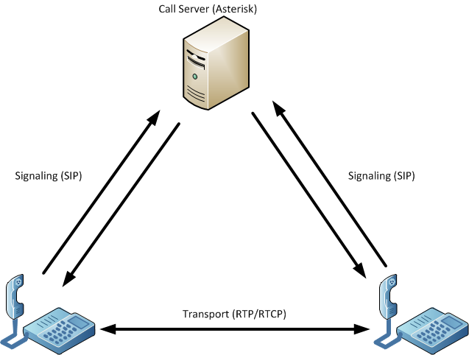
Notes:
A typical VoIP architecture encompasses a call server and phones. Often, the phones will perform signaling with the call server, which will help them setup the call. Once the call is established, the actual audio/video flows directly between the two endpoints. However, some solutions do use the call server to proxy all media. This can be a source of a bottleneck.
Two phones can also signal directly to each other using SIP or H.323, and establish a call without a call server. There could also be multiple call servers involved, and this is often the case with complex topologies or calls routed via the Internet.

Slide 8
Some Subjective Opinions from the Author
Notes:
Just my two cents about some of these protocols, with some examples of packet formats. Keep in mind that I’m not an expert by any means, so I’m just giving initial impressions.

Slide 9

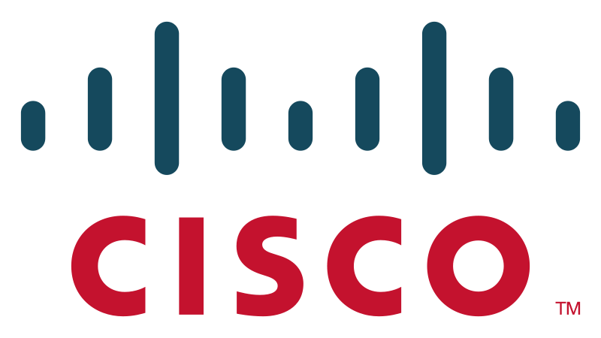
SCCP – Skinny Client Control Protocol
CCCP
Nice, clean protocol. But proprietary
Notes:
CCCP, SCCP. I tend to get them confused. At any rate, Skinny is a very clean protocol, and is very easy to interpret in packet captures. However, it is proprietary.

Slide 10
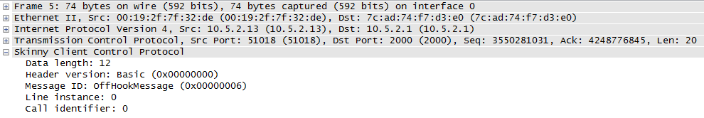
Notes:
Notice the simple, direct message. It’s pretty obvious that the phone has gone off-hook (hence the OffHookMessage). Also notice that it’s a pretty small packet.

Slide 11
SIP – Session Initiation Protocol
Standardized, gaining popularity, nice packet format
Notes:
SIP is a pretty long RFC that encompasses a whole bunch of stuff. It’s very powerful, yet still easy to interpret.

Slide 12
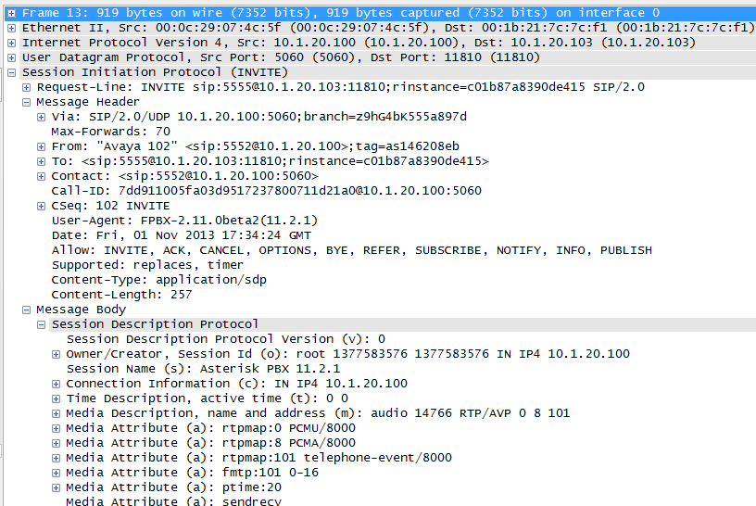
Notes:
Notice the clear message format. It’s obvious who the call is going from/to. The expanded Session Description Protocol also provides for capabilities exchange of information such as supported codecs. Although it’s busier than the previous Skinny message, it’s still easy to interpret what is going on.

Slide 13
H.323
Oh God, kill it with fire.
Notes:
Nah, just kidding. It’s a very powerful protocol.

Slide 14
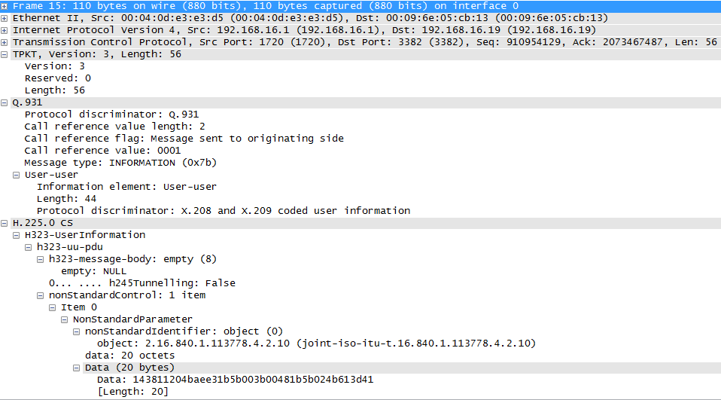
Notes:
Look at all of the headers and fields. There’s just a lot of stuff going on in H.323, and it’s not at all obvious what is actually happening. I like to debug by looking at packet captures, and I’ve found H.323 to be too heavy. In this case, there’s some proprietary non-standard data. It’s a very heavy protocol, but it’s also very powerful.

Slide 15
Back to Security - Vulnerabilities
Like most networks, we can consider several vulnerabilities
Protocol vulnerabilities
  Focus of this presentation
  What are the weaknesses in signaling and transport?
Architectural vulnerabilities
  Misconfigured dialplans lead to toll fraud
  Misconfiguration allowing anyone to register a phone
  TFTP
Notes:
Architectural vulnerabilities are a big deal, as they are with any other technology. Misconfiguration of a public-facing (or even company facing) voice server can result in severe financial losses. Consider the cost of international calling. If anyone can get their way into your voice server and make international calls, then they can run up a hefty tab.
Standard architectural vulnerabilities apply: DoS, ARP poisoning, forcing a switch to spew traffic out of all ports, etc.

Slide 16
Quick note about TFTP
This varies a lot by implementation, vendor, and version
Here’s just a quick look using an older Cisco phone
Phone will request SIP<MAC>.cnf file
So, if you know the phone’s MAC, you can make a TFTP request for it’s config and spoof
Notes:
Older Cisco phones would just request the SIP<MAC> file from the TFTP server. So, if you can figure out the address of the TFTP server, then it’s trivial to pull down configuration (including passwords) for a phone.

Slide 17
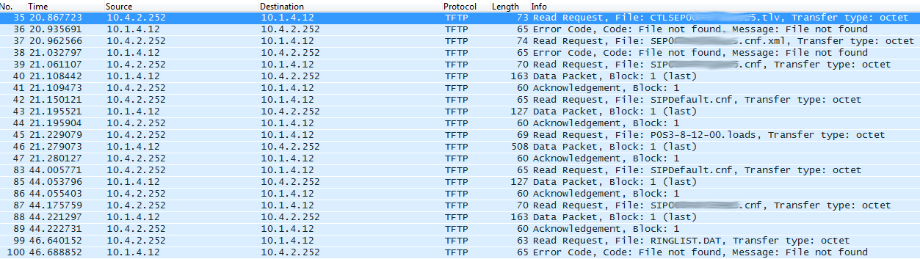
Notes:
TFTP flow

Slide 18
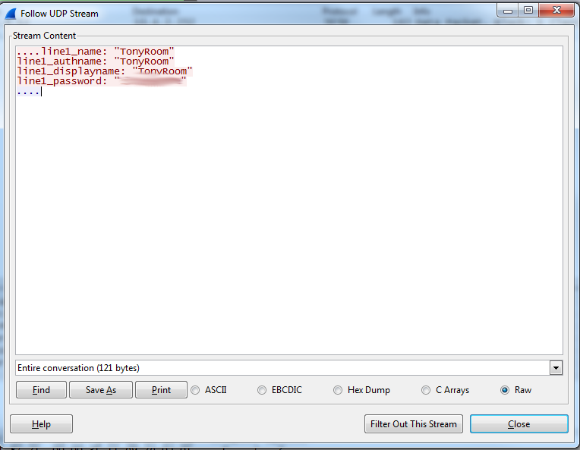
Notes:
And you can see the login info for my SIP phone.

Slide 19
Signaling Vulnerabilities
We mostly have two problems:
  Lack of encryption
  Lack of strong authentication
Consider SIP
  No encryption – information gathering
    Call source and destination info, phone user agent, etc.
  No strong authentication – spoof a phone or SIP packets

Slide 20
SIP Authentication
Authentication – Digest Access Authentication
  RFC 2617
  MD5 hashing on a nonce value
    Not particularly difficult to reverse
  This is also used in HTTP Authentication
Sipcrack – tool to sniff logins and crack digests based on wordlists
  You can also feed it pcaps
Notes:
Digest Access Authentication is very weak. The call server sends back a nonce value that is hashed using MD5 by the client. This is then sent back to the server. This method was originally created for HTTP, and is not a strong method of authentication.
Sipcrack is very easy to use. If you just capture a SIP exchange, you can dump the MD5 hashes and then run a wordlist against them. Assuming there’s a match, you’ll end up with the password.

Slide 21
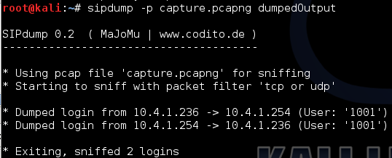
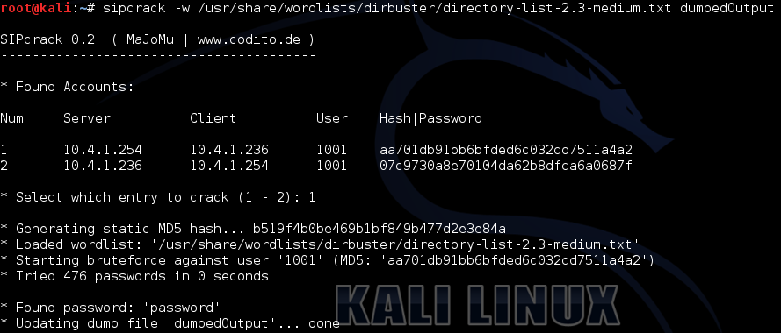
Notes:
Using sipcrack.
Sipdump (installed by default on Kali) is used to extract the logins. The “-p capture.pcapng” tells it to read from the “capture.pcapng” capture file, which was obtained using Wireshark. “dumpedOutput” is just the name of the file to send the extracted logins to.
Sipcrack does the actual cracking. The “-w” flag provides the wordlist to use.
The password here was simple for demonstration purposes: password

Slide 22
SIP Encryption (or lack thereof)
Unencrypted
  Easy to spoof
  Easy to gather information
Spoofing – make phones ring, redirect calls, etc.
Information gathering – most obvious is calling history
  But consider if DTMF is sent over SIP. Credit card numbers, etc.
Notes:
There are a lot of tools that exist to extract and present information from SIP calls, or spoof SIP messages.
DTMF – Dual-tone multifrequency, is the method used to send key presses. If sensitive information is sent via SIP, such as credit card info or login to any sort of telephony service, then these might be sent in plaintext. Some solutions send DTMF over the media stream, but this isn’t any better if the media stream isn’t protected.

Slide 23
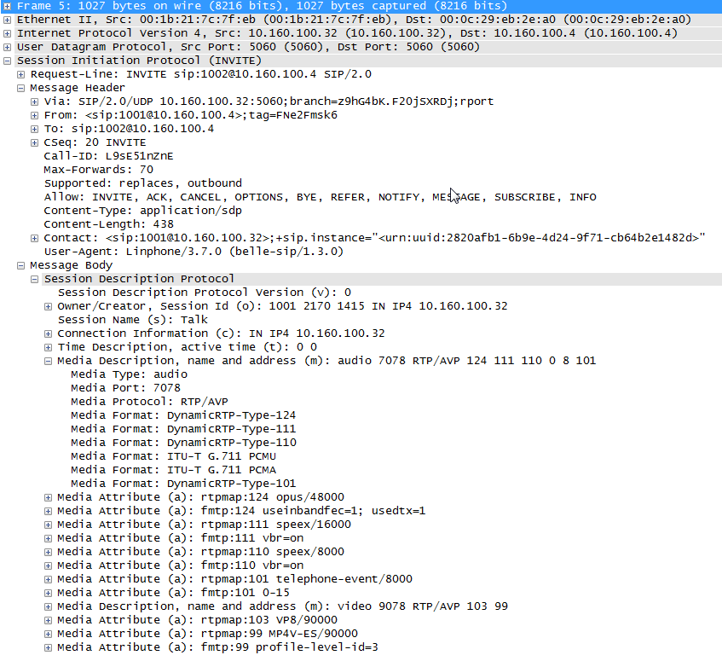
Notes:
Included to show the simple messages structure, and how much information can be gathered just by looking at a SIP packet. From this simple packet we can gather:
The calling and called parties
The different types of codecs supported by both
The user-agent (type) of phone used: Linphone version 3.7.0
We could also determine the length of the call if we captured the teardown sequence. This kind of information is very telling, as we often consider telephone conversations to be a very private matter.

Slide 24
Transport Vulnerabilities
RTP/RTCP
  Unencrypted, unauthenticated, no integrity checks, etc.
  So, we can:
    Listen in on conversations
      Wireshark makes it easy!
    Play back arbitrary voice/video
      Easy to do by incrementing sequence number
    Modify data in transit
Notes:
Wireshark is able to reconstruct RTP audio that uses G.711.
Tools exist to insert arbitrary audio into a stream. RTP carries a sequence number. However, if you simply increment the sequence number high enough, then the receiver thinks that it’s missed a bunch of packets and just starts playing the audio that you’ve sent.

Slide 25
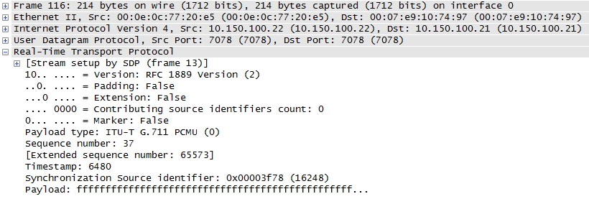
Notes:
Notice the simple format of RTP, the plaintext payload, and the sequence number.

Slide 26
Packet Playback in Wireshark

Slide 27
So, how do we fix this?
The SIP RFC actually supports TLS!
  It’s not that complicated! At least not in theory.
  Sometimes called Secure SIP
  All signaling then rides over the encrypted channel
  Administrative overhead
RTP/RTCP is more complicated
  There are lots of ways to secure the actual audio. We’ll discuss a few.
Notes:
SIP is pretty straightforward – leave encryption up to TLS. I say it’s not difficult “in theory” because certain vendor implementations leave a lot to be desired, particularly in ease of configuration and documentation surrounding TLS configuration.

Slide 28
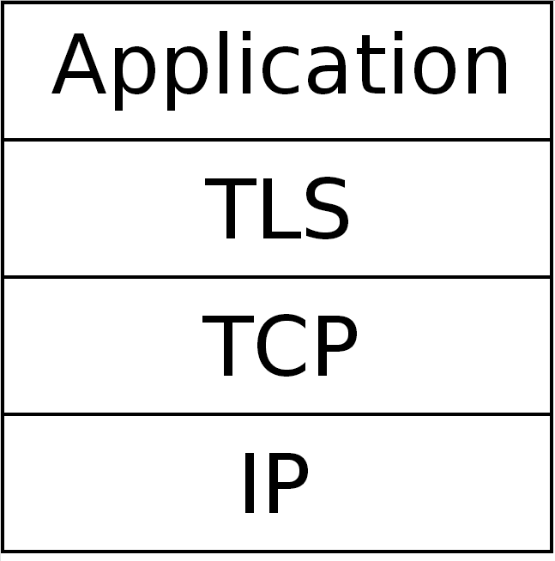
Notes:
Just a reminder of where TLS would live in the stack. Upon completion of a TLS handshake,

Slide 29
Securing Transport
Let’s discuss some general challenges
We need to somehow exchange a key for encrypting audio
  Exchange it in the signaling protocol
    But then we rely on signaling being secure, or supporting security extensions
  Exchange it in the transport protocol
    Then we don’t have to worry about signaling security
Notes:
Exchanging in the signaling protocol also introduces other complexities. Can each hop along the way be trusted to pass along keying information? Does each hop along the way support secure signaling? While this is all easy to control within the LAN, once you enter the Internet it becomes more complicated.
Exchanging in the transport protocol has an obvious benefit: who cares if the signaling protocol is insecure/poorly implemented/etc? The calling parties worry about key exchange between themselves.

Slide 30
Notes:
Just a reminder about the diagram and where key exchange can occur

Slide 31
Method 1: SDES
Session Description Protocol (SDP) Security Descriptions
An extension to SIP, specifically to SDP
Key exchange is done within SIP
But what if SIP isn’t secure
  That’s fine if you’re using a key exchange algorithm
  Not so fine if you’re shooting a master key over an unencrypted SIP channel
Notes:
SDES essentially allows for key exchange to occur within SIP signaling packets. As mentioned, if SIP isn’t secure, then this can fail. I have heard of solutions requiring you to have secure SIP enabled before allowing you to do SDES.

Slide 32
Method 1: SDES
If you can’t count on SIP being secure, then use some sort of key agreement protocol
  Multimedia Internet Keying (MIKEY) being the main one
    MIKEY also supports several key exchange methods
Failure to use a proper key agreement protocol results in plaintext exchange of master key
  See next few slides
Notes:
RFC 4568 for SDES mentions some different types of Authenticated Key Establishment (AKE) procedures. Essentially, SDES just provides a medium to exchange a key (SDP within SIP), but it does not specify the actual key exchange protocol.

Slide 33
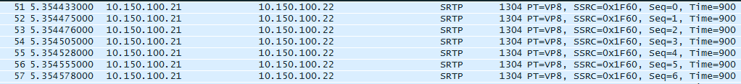
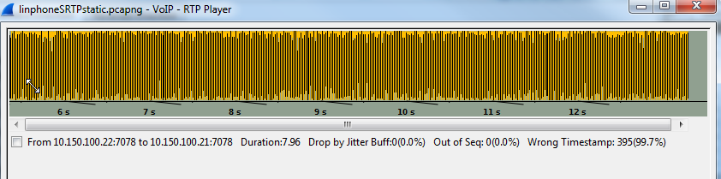
The encrypted RTP just results in static

Slide 34
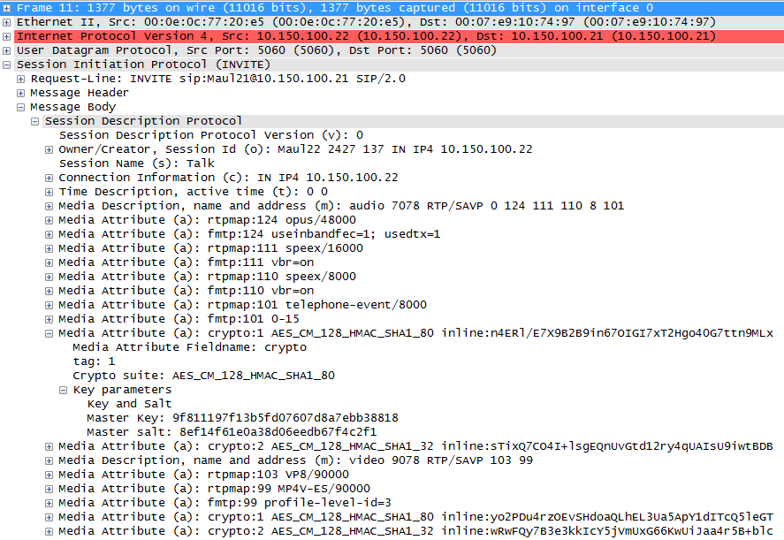
Notes:
Notice that the key information is exchanged in plaintext, as the transport layer is not encrypted. Grabbing the key is therefore trivial.

Slide 35
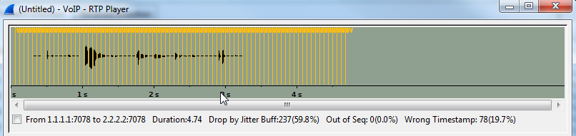
But once we have the master key, the RTP can be decrypted and replayed
Notes:
I used this program to decrypt: https://github.com/gteissier/srtp-decrypt
There are a few steps involved, I hope to have a thorough write-up online at some point in the near future.

Slide 36
From RFC 4568 (SDES)
It would be self-defeating not to secure cryptographic keys and other parameters at least as well as the data are secured. Data security protocols such as SRTP rely upon a separate key management system to securely establish encryption and/or authentication keys
AKE is needed because it is pointless to provide a key over a medium where an attacker can snoop the key, alter the definition of the key to render it useless, or change the parameters of the security session to gain unauthorized access to session-related information.
Notes:
I hate walls of text, but this is an appropriate quote. Clearly, Linphone (the soft-client used in the previous slides) doesn’t care about this sort of thing.

Slide 37
Method 2: DTLS
Allows for TLS over UDP
  Lost/reordered/fragmented packets cause problems for TLS
Only small modifications made to TLS
  Retransmission timer
  Explicit state and sequence numbers added to records, allowing for re-ordering
  RFC 4347 does more justice to this
Emerging with WebRTC
Notes:
DTLS largely just implement TLS over UDP, with very few modifications to solve the issues presented by unreliable transport. Packets arriving out of order, not arriving at all, and datagram size limits all pose problems for TLS. The DTLS RFC introduces minor changes to resolve these issues.
I have not seen too many implementations touting DTLS for VoIP/UC. I don’t know why this is. Maybe I’m not looking hard enough. At any rate, it doesn’t jump out when searching around for VoIP security solutions. There would definitely be additional administrative overhead associated with DTLS, mainly in certificate management.
WebRTC is a project to allow for real-time communication within web browsers.

Slide 38
Method 3: ZRTP
In-band security setup (RTP), doesn’t rely on signaling protocol
Ephemeral Diffie-Hellman
  Establishes master keys that are used to derive session keys
But isn’t Diffie-Hellman vulnerable to MiTM?
  Yes.
  Use a Short Authentication String (SAS)
Notes:
The calling parties establish a master key using Diffie-Hellman. This master key is then used to derive session keys, with periodic rekeying. This removes the burden of key exchange from the signaling protocol. It also greatly simplifies the key exchange. Instead of having to use SDP and figuring out the actual key exchange method used (ex: MIKEY and all of it’s supported exchange methods), this distills it down to one method: Diffie-Hellman.

Slide 39
ZRTP Continued
Short Authentication String
  Based on DH values such that two different DH handshakes would result in differing values.
  I haven’t had time to really read the RFC, so sorry that I don’t have any math specifics.
  Users verbally compare the string values.
    If different, then suspect MiTM
ZRTP also uses a cached “Retained Secret” based on initial keying material from first call
  Limits attack window to first handshake of first call
Notes:
It’s very important that users verbally compare strings. Any attempt to automatically compare the strings would be useless, as it could be captured and manipulated by the MiTM.

Slide 40
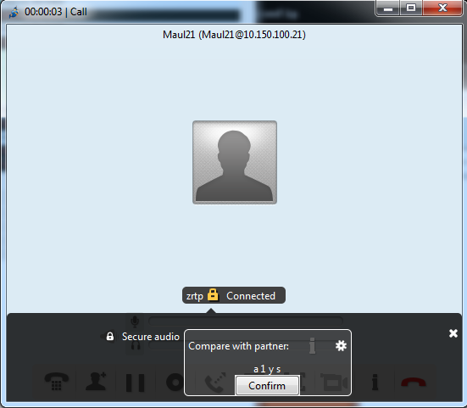

Slide 41
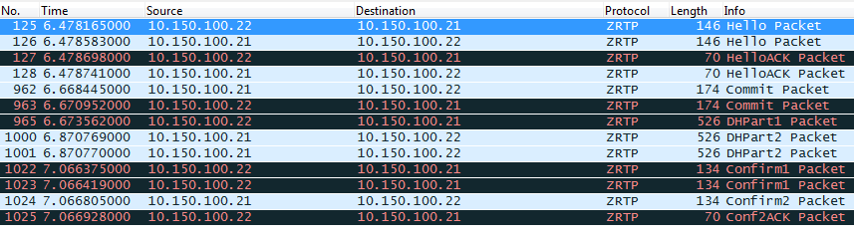
ZRTP Handshake

Slide 42
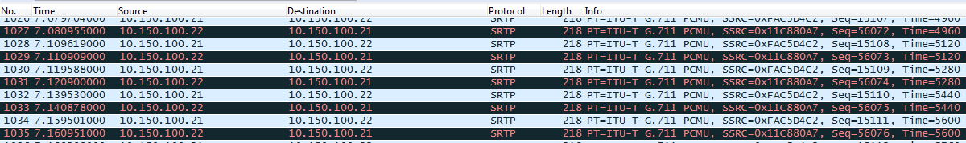
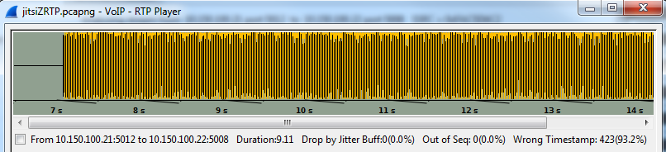
Result – SRTP and Static

Slide 43
So we have all these solutions
Therefore, phone calls must be secure! Right?
  Nah.
Implementations can be abysmal
Significant administrative overhead
  We just talked about protocols. Don’t get me started about PBX and endpoint configuration
  Although totally integrated vendor solutions tend to be OK.
The ideas and protocols are there, but the implementation can be shoddy
Notes:
Implementations can be very poor. Comprehensive vendor solutions may be better (ex: Cisco, Avaya, etc), but then this requires the use of all of that vendor’s equipment. This may be fine for an enterprise that is willing to invest in such a solution, but it isn’t really ideal if the goal is to have secure VoIP widely supported on the Internet using vendor-neutral protocols.
Administrative overhead for security configuration can be significant. Consider Asterisk. The documentation for configuring secure SIP or secure transport is very poor. And I love Asterisk. Softphone clients (and even firmware for physical phones) can be poorly written. Linphone will just crash if you send it a poorly crafted SIP packet. It also won’t bother telling you if it fails to establish a ZRTP stream, leaving the user ignorant.

Slide 44
Conclusions and Takeway
Two protocols: signaling and transport
Signaling security is “easy” with SIP
  Just use TLS
Transport security provides an array of options
  I’m a fan of ZRTP
Great area for research
  Both protocol and implementation
    Especially implementation

Slide 45
References and Resources
RFCs
SIP – 3261 RTP – 3550
SDES – 4568 ZRTP – 6189
DTLS - 4347
Additional Resources
http://www.zrtp.org/zrtp-protocol
http://wiki.freeswitch.org/wiki/SIP_TLS
https://www.isecpartners.com/media/12973/isec-garbutt-lackey-point-click-rtp-inject%20-bh07.pdf

Slide 46
Questions?

